Slide 1
Deliverable 5
Adam Afilaka: Developer/Programmer
Ashley Braun: Business Analyst/Project Manager
Zaid Islam: Cyber Security Engineer
Rithika Sayini: Researcher/Programmer
Shanese Scott: Database Administrator
Xin Zheng: Quality Assurance

Slide 2
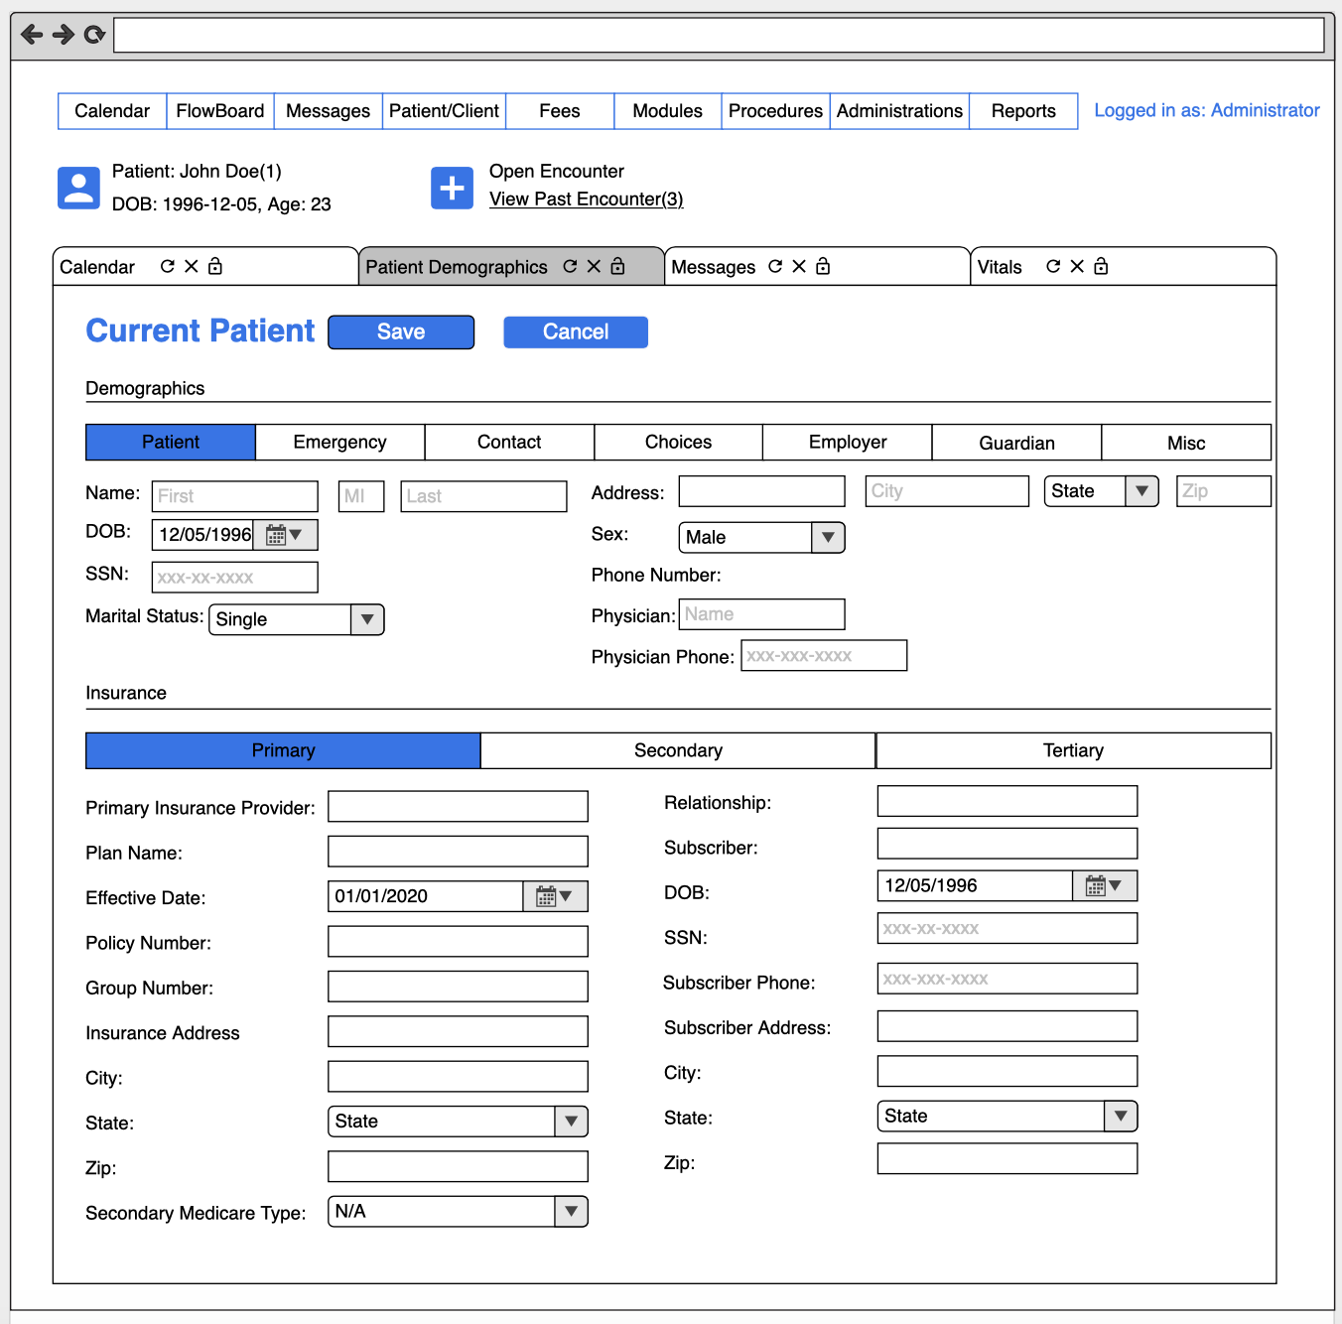
User Interface
Patient Demographics

Slide 3
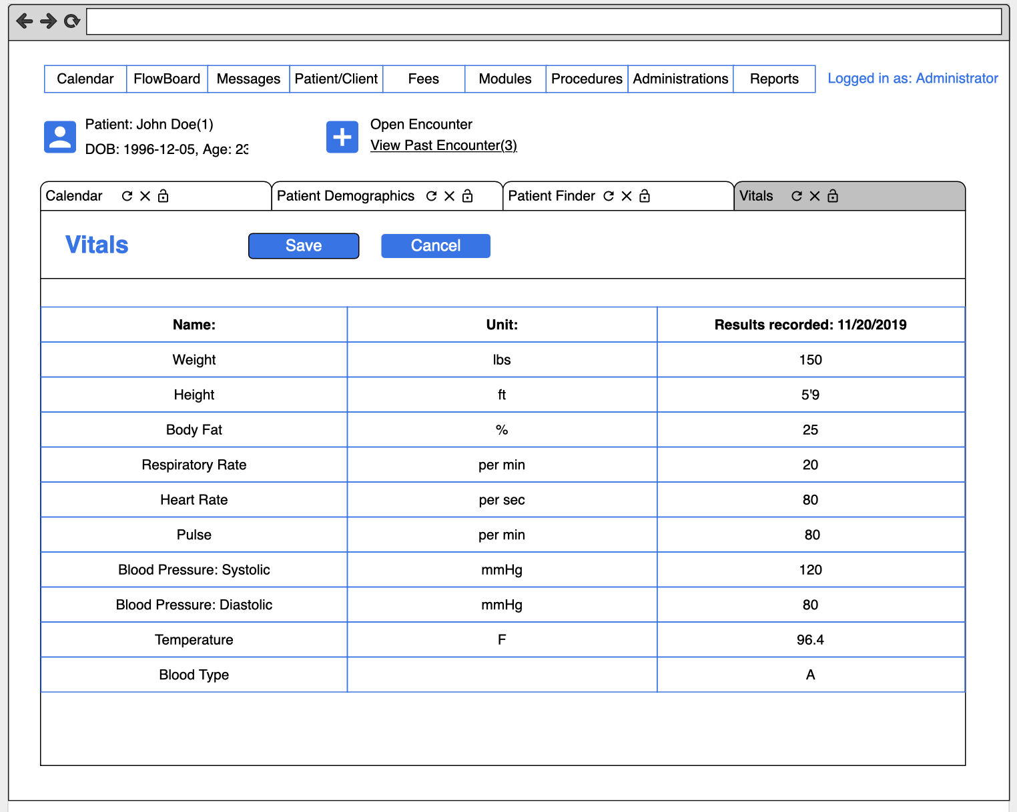
User Interface
Vitals

Slide 4
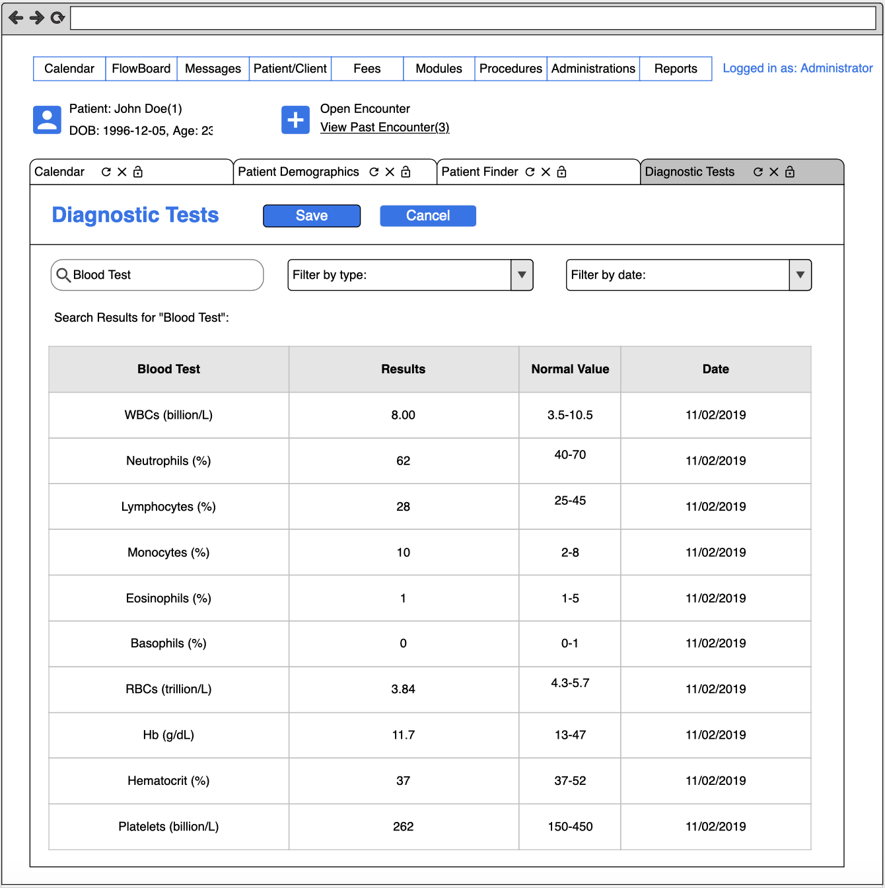
Program Design
Diagnostic Tests

Slide 5
Interface Standards to Follow & Make Decisions
Patient Demographics
Restricted to entry by qualified HCPs
Personal identifying information
Does not trigger events
Assists calculations to determine WNL and abnormal values (e.g., BMI)
Vitals
Collected/administered through device
Is also manually entered by a HCP (& restricted thereto)
Abnormal events trigger a decision
Diagnostic Tests
Restricted entry for radiological, pathological, and laboratory results by a HCP
Abnormal results trigger an action
“see Cardiologist”, “see Pulmonologist”, “see Endocrinologist”
Can provide a treatment plan: “take 2 baby aspirin daily”
System generated decisions/plans are reviewed by HCP

Slide 6
System Implementation
Software Requirements:
MySQL
OS (Linux, Windows, and macOS)
Hardware Requirements:
16-64 GB of RAM
Disk Space 250 GB or higher
8-16 core processor
High speed drive (SAN)
Server Requirements:
32 GB
Database Requirements:
Backup Compression
ACID Properties
Replication
Ordered key-value store
Layers

Slide 7
SDLC Process
 | Deliverable 1 Planning | Deliverable 2 Design | Deliverable 3 Implementation | Deliverable 4 Testing | Deliverable 5 Maintenance
Advantages, Pros, and Assets | Team background Establishing a concept | DFD Charting Breaking down of Processes with team members | Data devices and management effectiveness | Sharing product to stakeholder was informative on innovation onto giving a better understanding on how data works in big companies for health services | Reviewing the System conceptually allowed to see rooms for improvement and better understand of data protocols to for better action
Disadvantages, Cons, Difficulties, and Liabilities | Understanding core elements Split decisions on certain needs | Connecting processes to match in sync data amongst transfer | Correcting which alternatives would best fit by which scenarios during data transmission | Establish improvement in scalability and flexibility for future marketing | Redundancy in work around, and more time to communicate is needed to better go into detail each phase. Time is important
Comments: | Overall, general understanding on the required functions of an EMR system to meet real-time transfer of data | Main focus was to establish that the system would create and send constant information based on appropriate scenarios | Perfecting a system to a point of reliable, secure, and efficient transfer of data following procedural protocols | We understood that a system such as this would have to grow and integrate well into the already massive health IT infrastructure and that takes time | We come to learn that through the conceptualization of our EMR system that it needs to be kept on constant maintenance in an effort to grow and function.

Slide 8
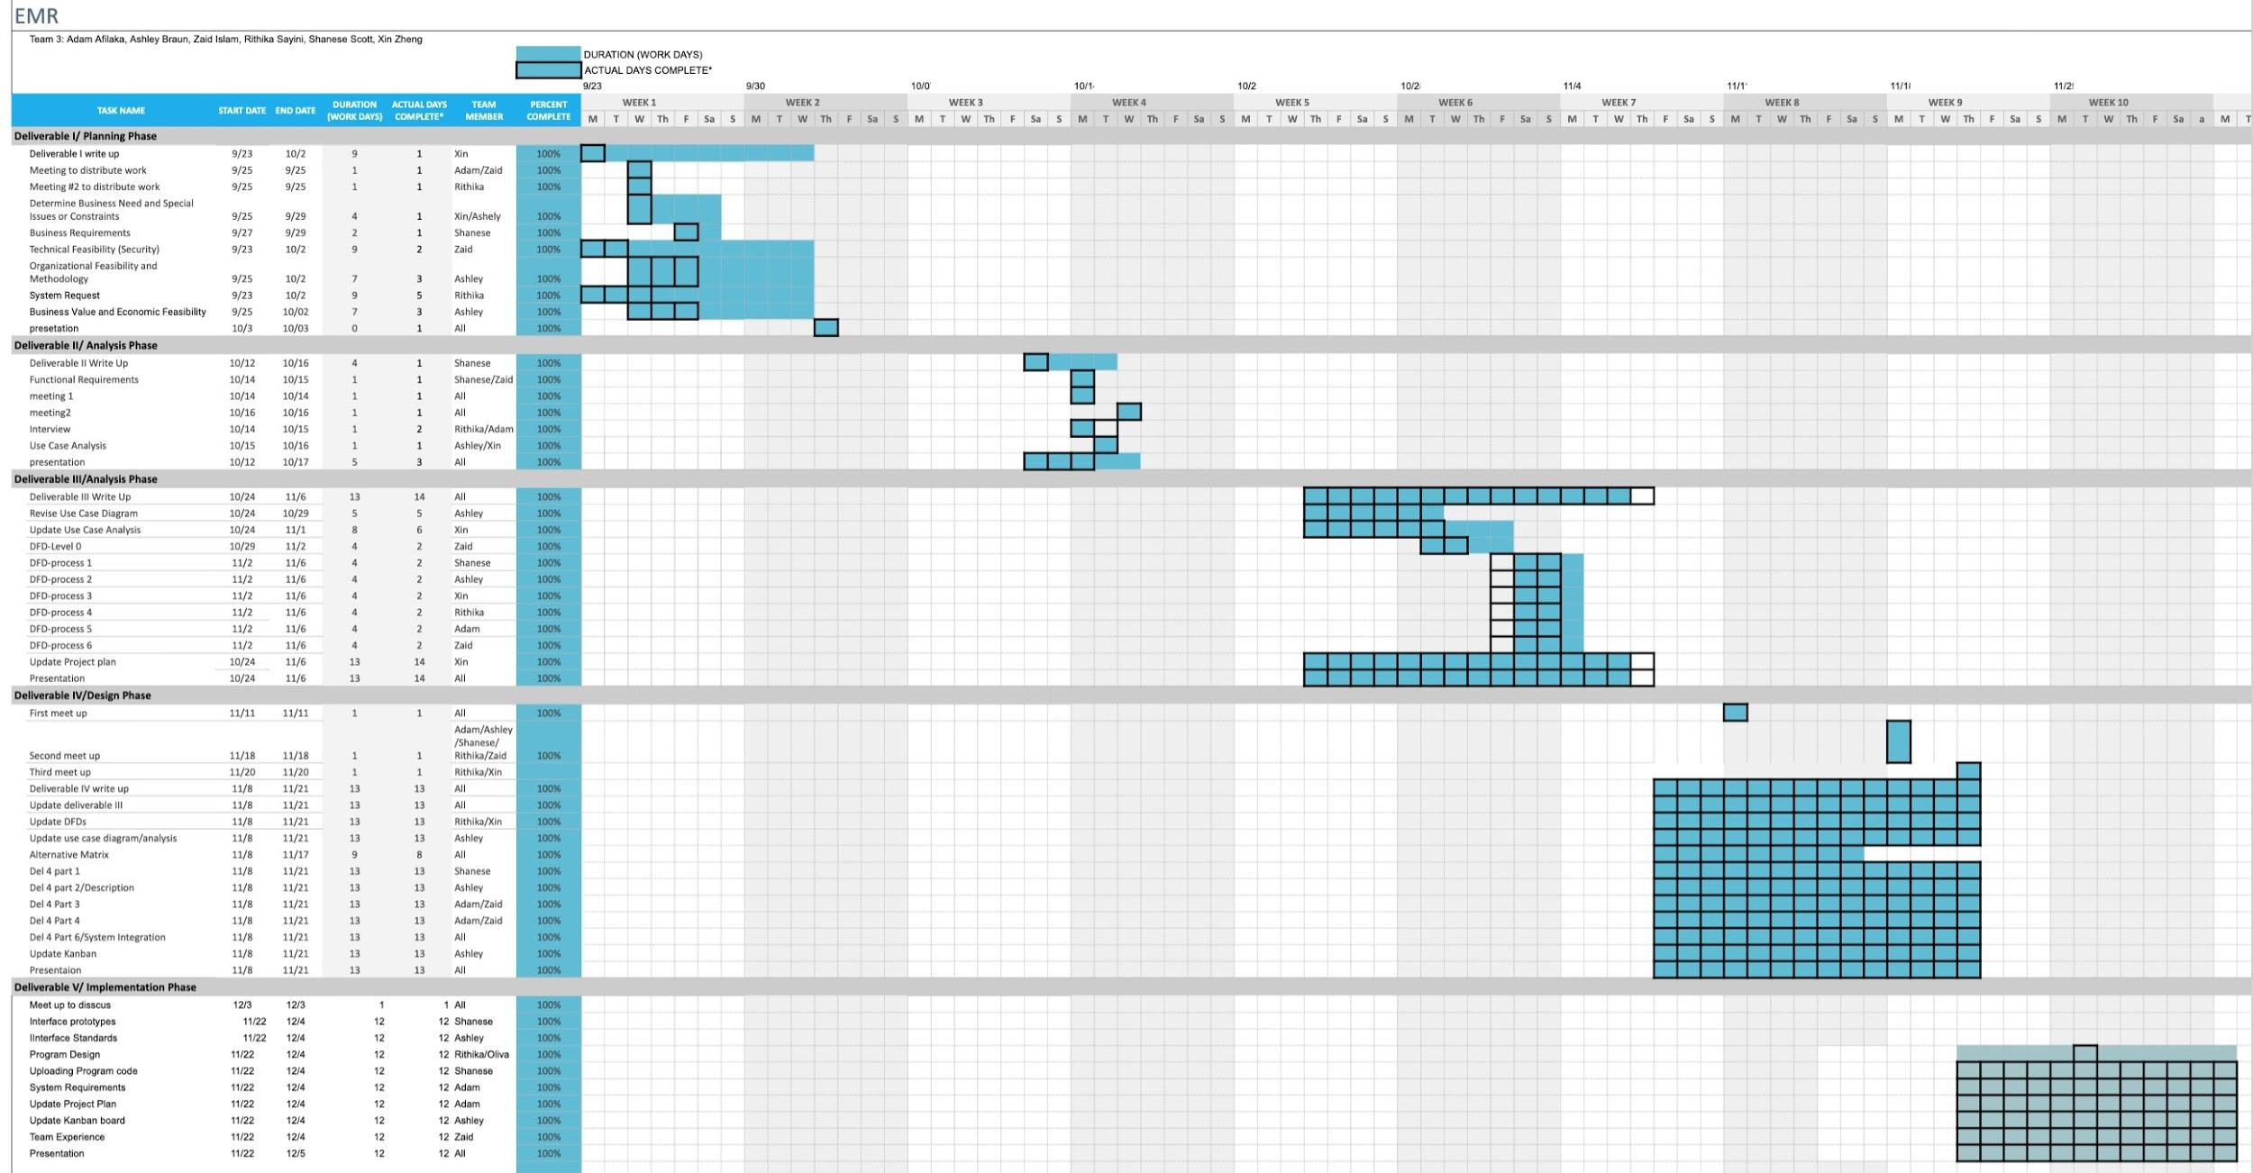
Project Plan

Slide 9
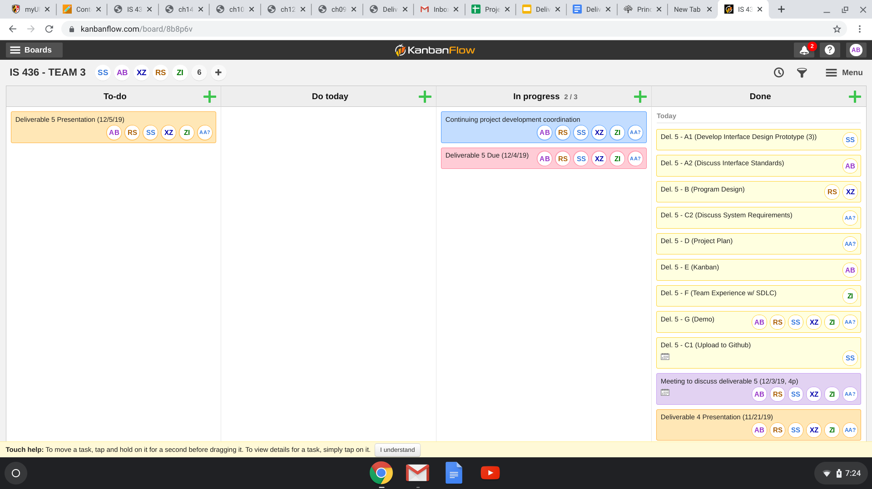
Kanban

Slide 10
DEMO
https://swe.umbc.edu/~scsh1/ehrsystem/Tab.html

